Slide 1

UNLOCKING2.0
Under the esteemed Guidance of
Mr. B. RAMANA REDDY, M.TECH(CS)
Assistant Professor
By
GEETHA KRISHNA P 16AK1A0518
BALAKRISHNA B 16AK1A0504
PAVANKUMAR B 16AK1A0550
JAYAGANESH K 16AK1A0528
Department of Computer Science and Engineering
Annamacharya Institute of Technology and Sciences::Tirupati. (Approved by AICTE, New Delhi & Permanent Affiliation to JNTUA, Anantapuramu.) Accredited by NBA, New Delhi. Accredited by NAAC, Bangalore.
Venkatapuram (V), Karakambadi Road, Renigunta (M), Tirupati – 517 520 – A.P

Slide 2





IN ASSOCIATION WITH

Slide 3
UNLOCKING 2.0

Slide 4
contents
Abstract
Introduction
Game info
Software and hardware requirements
Goals of UML diagrams
Uml diagrams
Class diagram
Use case diagram
Sequence diagram
Activity diagram
Deployment diagram
Object diagram
Data flow diagram
Implementation
All screens in game
Testing and validation
Conclusion &future enhancement
Play store
Reference

Slide 5

abstract
Game logo :-
Unlocking 2.0 game is all about testing reflexes of the player’s brain.
In this game, you’ll be given a random number/alphabet on screen and there will be a
dotted matrix below just as pattern in your mobile.
Players are supposed to connect those dots according to the number given above within the time limit.
You can unlock consecutive maps when you reach the minimum required keys.
There will be five chapters with different levels in it and each level consists of 3 games that should be completed within given time.

Slide 6
introduction
Unlocking 2.0 is a puzzle game.
Game is all about testing reflexes of the player’s brain.
Game consists of two modes namely CLASSIC & ARCADE.
In classic mode they are five chapters(normal, memorized, reverse, alfabeto and advanced).
All this chapters having 1 to 20level’s.
Arcade mode is based on time laps and to get high score.

Slide 7
Game info
2D
Single Player
Made with Unity Engine
Compatible with Android Devices
A mind reflex Game (Puzzle)
And the theme is about how fast your brain is going to react
Playable by above 10+ years

Slide 8
SOFTWARE & HARDWARE REQUIREMENTS
Operating System (API level): Android 5.0 ‘Lollipop’ (API level 21) (64-bit versions only) and above
Resolution: 1920*1080
Processor: Qualcomm Snapdragon 600 and above
Number of Cores: 4
Frequency: up to 1.7 GHz
Instruction Set: ARMv7 32 bits
Graphics: Adreno 320
Clock: 400 MHz
Cores: 96ALUs
Memory: 1GB
Storage: 100MB

Slide 9
UML DIAGRAM’s
UML stands for Unified Modeling Language. UML is a standardized general-purpose modeling language in the field of object-oriented software engineering.
The standard is managed, and was created by, the Object Management Group. The goal is for UML to become a common language for creating models of object oriented computer software. In its current form UML is comprised of two major components: a Meta-model and a notation.
In the future, some form of method or process may also be added to; or associated with, UML.
The Unified Modeling Language is a standard language for specifying, Visualization, Constructing and documenting the artifacts of software system, as well as for business modeling and other non-software systems.

Slide 10
Goals of UML diagrams
The Primary goals in the design of the UML are as follows:
Provide users a ready-to-use, expressive visual modeling Language so that they can develop and exchange meaningful models.
Provide extendibility and specialization mechanisms to extend the core concepts.
Be independent of particular programming languages and development process.
Provide a formal basis for understanding the modeling language.
Encourage the growth of OO tools market.
Support higher level development concepts such as collaborations, frameworks, patterns and components.
Integrate best practices.

Slide 11
Class Diagram
In Class Diagram shows 5 classes Namely Main menu, Scoreboard, Classic mode ,Arcade mode player rules.
The Relationship between Main menu and Scoreboard is aggregation.
Player rules class is fully dependent on Scoreboard class, So the relationship is aggregation.
The Relationship between level controller to Main menu is normalization.
The Relationship between player controller to game object controller is association .

Slide 12
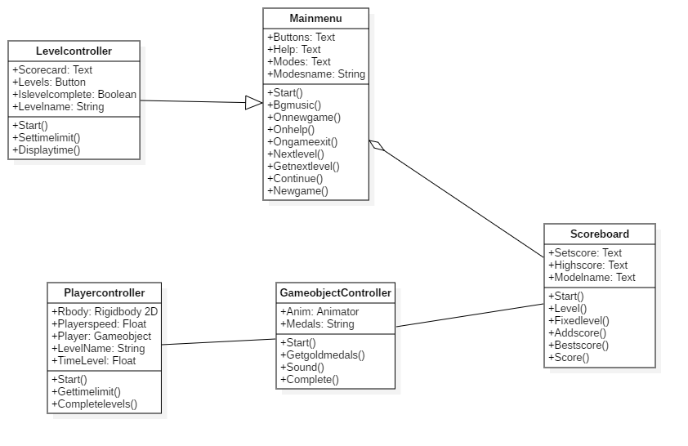
CLASS DIAGRAM

Slide 13
USE CASE DIAGRAM
In the Use Case Diagram, the actor is a player of the game.
In the Use Case Diagram we use association relationship only.
There are may use cases used in this game. Whenever the game is started, actor gets five use cases, either to open new game or go to options or choosing mode or choosing help or exiting the game.
When a user chooses to play new game, the new game will be start. Here, actor can either Play the game or quit the game.

Slide 14
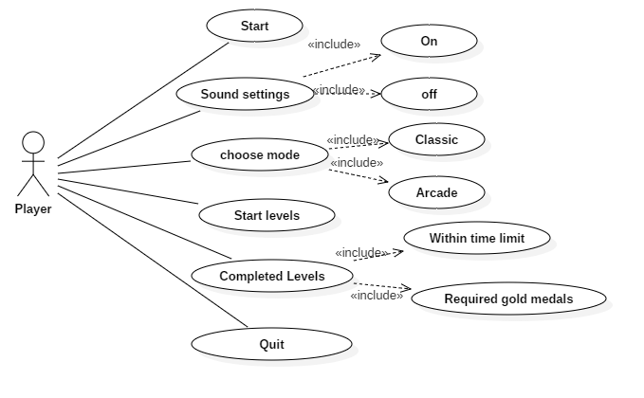
USE CASE DIAGRAM

Slide 15
Sequence diagram
In the sequence diagram, a player is an actor Main menu, Gameplay are the objects included in the sequence diagram as shown in the above diagram.
In the Sequence diagram the relation ships which are used is lifelines, Synchronous messages, Asynchronous messages ,create messages, reply messages.
An actor goes to the Main menu objects and then gameplay starts by interacting with Gameplay .
If Player choose the mode to play and goes to levels keeps on moving until completes the chosen level (currently playing level).
If level does not complete with gold medals again replay the game until the player gets Gold medals occurs then an actor can restart the game or go to main menu or exit from the game.

Slide 16
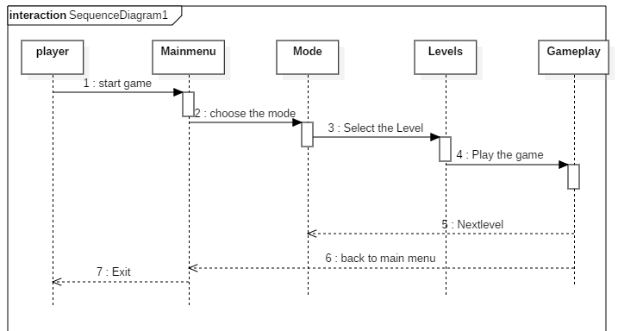
SEQUENCE DIAGRAM

Slide 17
ACTIVITY DIAGRAM
In the Activity diagram, the relationships we used are Activity, Control Flow, Initial Node, Join node, Fork node, Final Node, and Decision Nodes.
The Control flow starts from Initial node to Main menu, which is another activity, then based on player decisions the control flow continues to various activities by using Decision node, so that player can choose either New game or in game Options or help panel or player can exit i.e., control flow to final node.
Then player can choose different options based on the Activities, so in this game we have four menus which are Main menu, Game over menu and Quit menu .
The Control flow is dependent on the player interaction throughout the game.

Slide 18
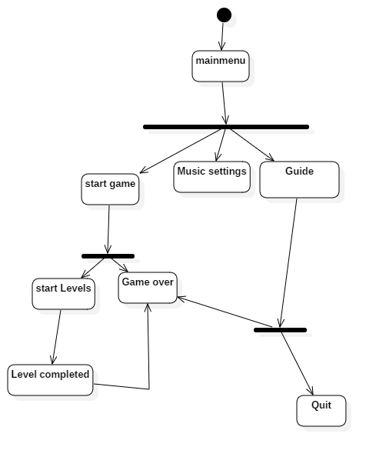
ACTIVITY DIAGRAM

Slide 19
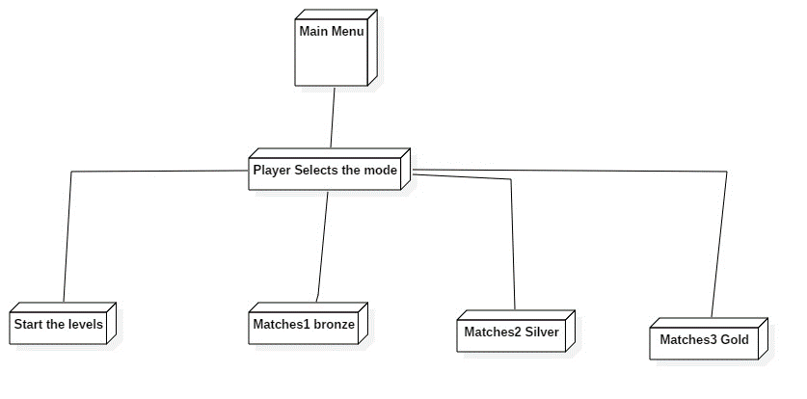
DEPLOYMENT DIAGRAM
In the Deployment Diagram shows that association relationship that indicates a message or other type of communication between nodes.

Slide 20
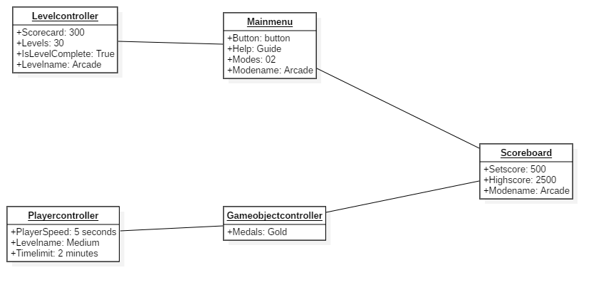
Object diagram
In this object diagram there are five object namely level controller, Main menu,
Player controller ,Game object controller, Scoreboard.
In these object diagram , we used Association relationship only.

Slide 21
Data flow diagrams (dfd)
The Data Flow Diagram (DFD) is a structured analysis and design method.
It is traditional visual representation of the information flows within a system.
Data Flow Diagram(DFD) is widely used for software analysis and design.
Data flow involves four symbols they are Process, Data object ,Data store ,External entity.
A neat and clear DFD can depict a good amount of the system requirements graphically.
In this there are having 3 levels namely
* Level 0
* Level 1 &
* Level 2
LEVEL 0 DFD
PLAYER
OPENING & PLAYING GAME
EXIT GAME

Slide 22
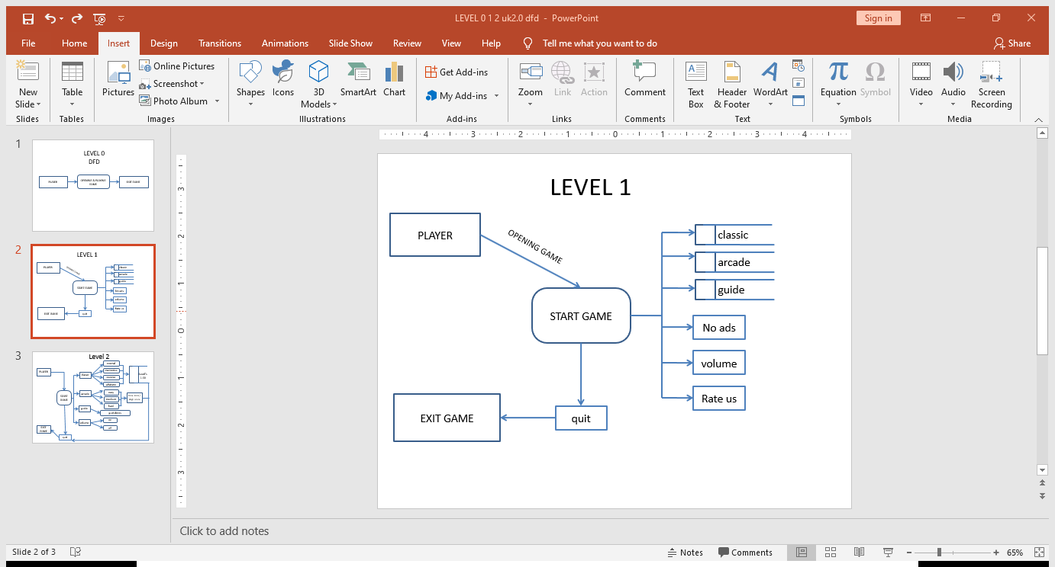
Level 1 dfd

Slide 23
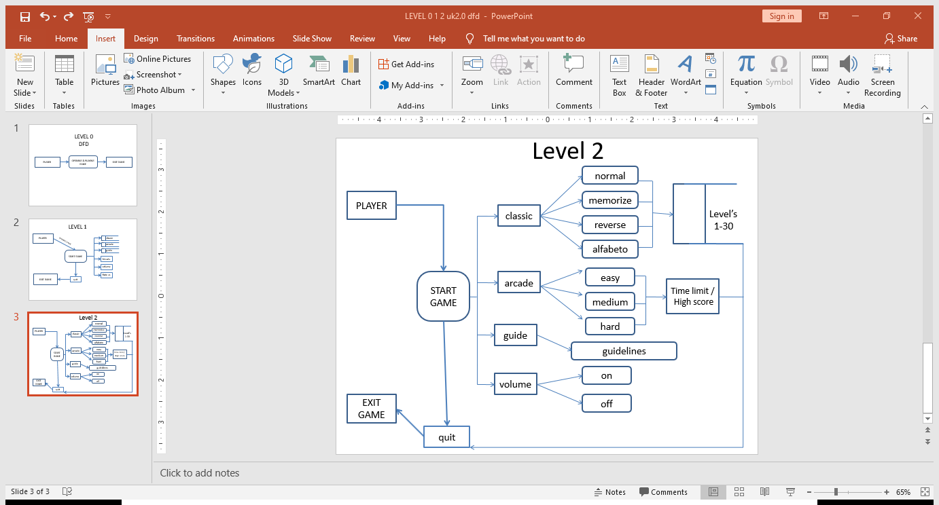
Level 2 dfd

Slide 24
implementation

Slide 25
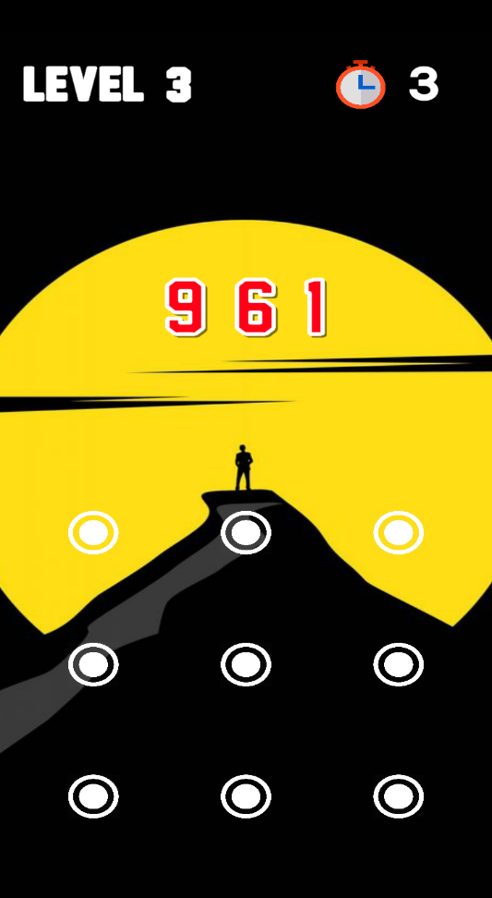
Modules
NORMAL
In Normal chapter the random number is generated and displayed at top of the screen.
The size of random number is relied on level to level.
It is very convenient to the players to play.

Slide 26
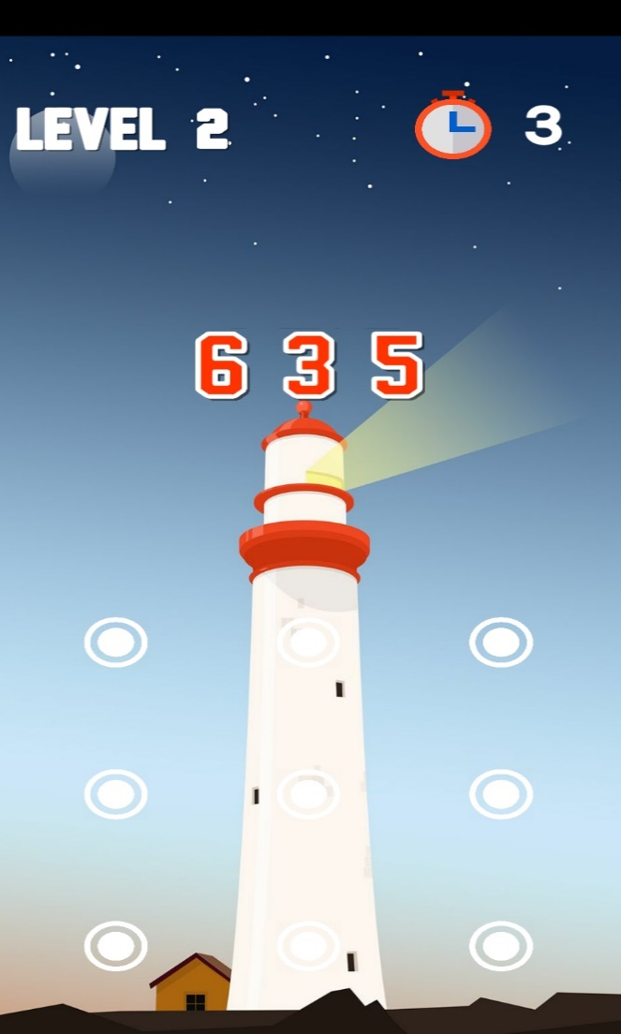
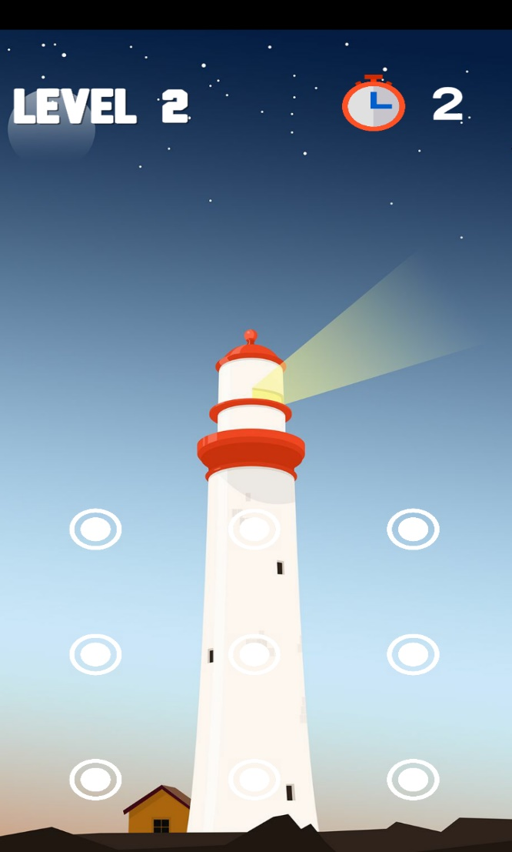
Modules
Memorise
In Memorise chapter we memorize the random number and number is set out over the screen in few seconds.
After the number disappears.
We should remember the number and drag the dots within a given time limit.
This chapter notices how much memory power you have to play these level .

Slide 27

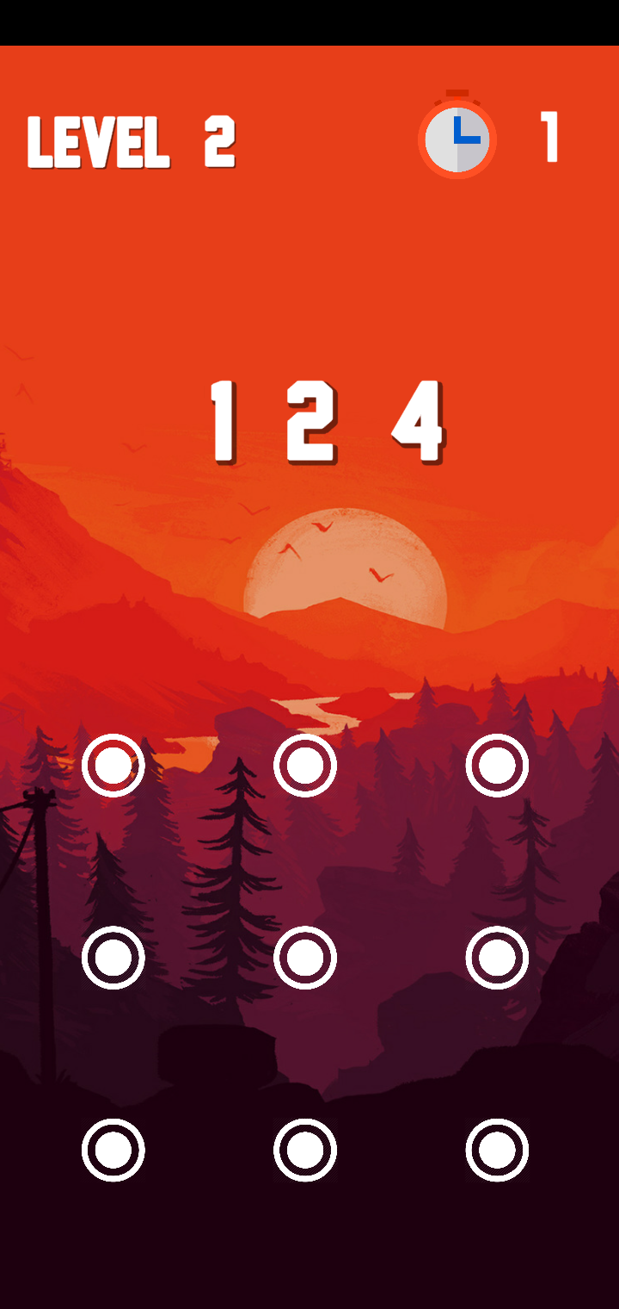
Modules
Reverse
In Reverse chapter the random number is generated and displayed at top of the screen in reverse manner.
Analyze the numbers and connect the dots in reverse.
It is complicated to the players to play.

Slide 28
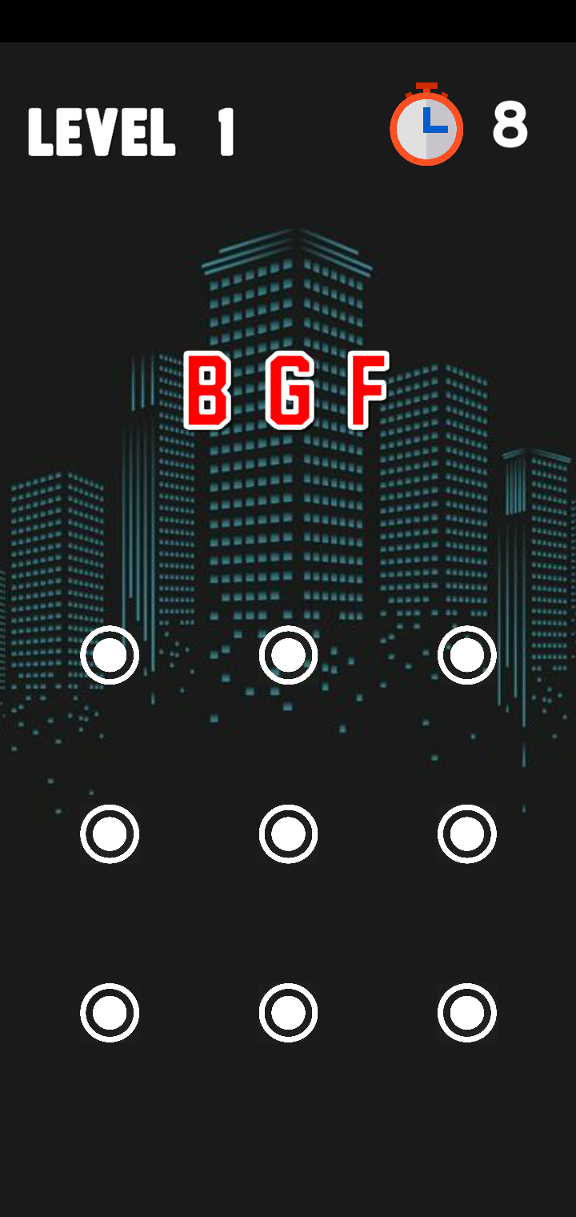
Modules
Alfabeto
In Alfabeto chapter the random alphabets is generated and displayed at the top of the screen.
Analyze the dots as numbers and connect those dots.
Example(A-1,B-2,C-3…...I-9)
It is bit of complicated to the players to play.

Slide 29
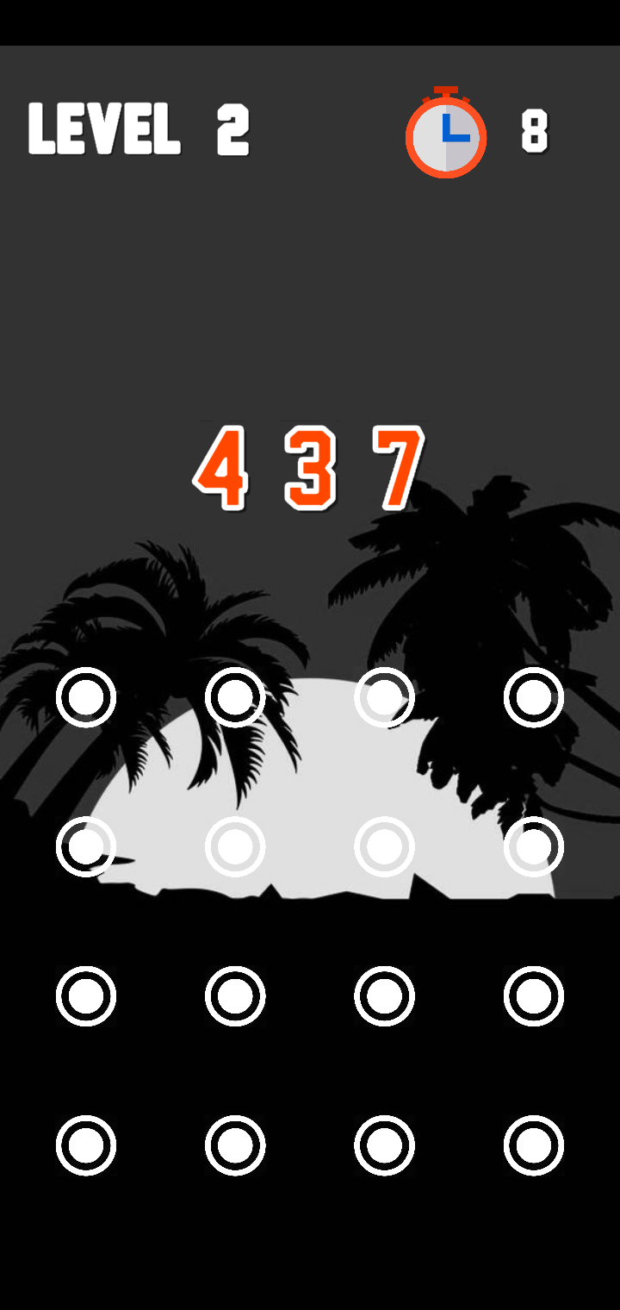
Modules
ADVANCED
In Advanced chapter it consist of 4x4 matrix the random number is generated and displayed at the top of the screen.
Advanced chapter will have 16 dots instead of 9.
It is more complicated to the players to play.

Slide 30
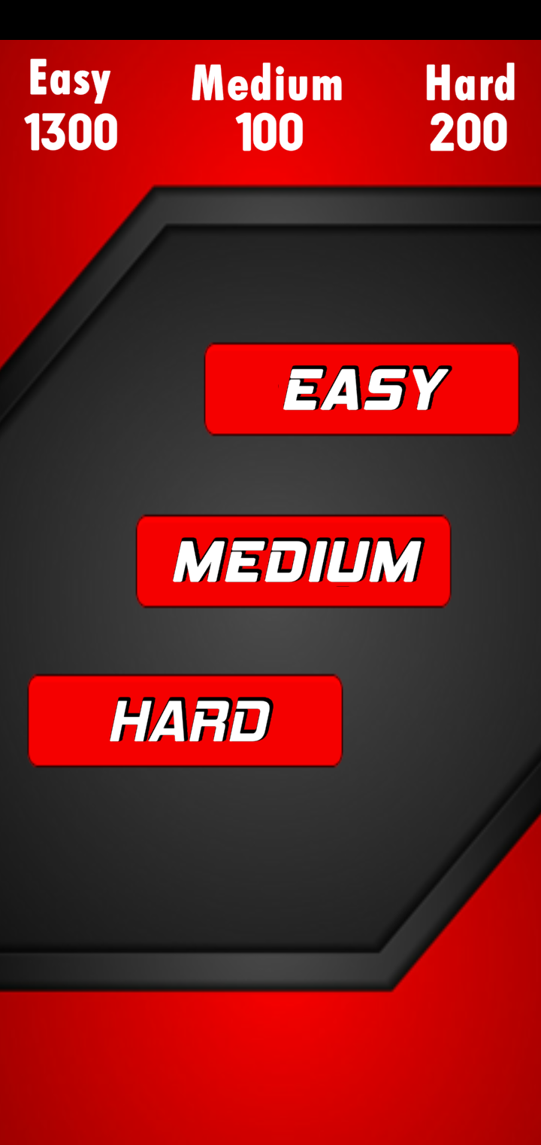
Modules
ARCADE MODE
Arcade mode is based on time laps and to get high score .
It is already in unlock position, directly you move and play in arcade mode it’s your capacity to answer as many questions you can in 60 sec in any difficulty level you want.
They are three chapters namely
Easy
Medium
Hard

Slide 31
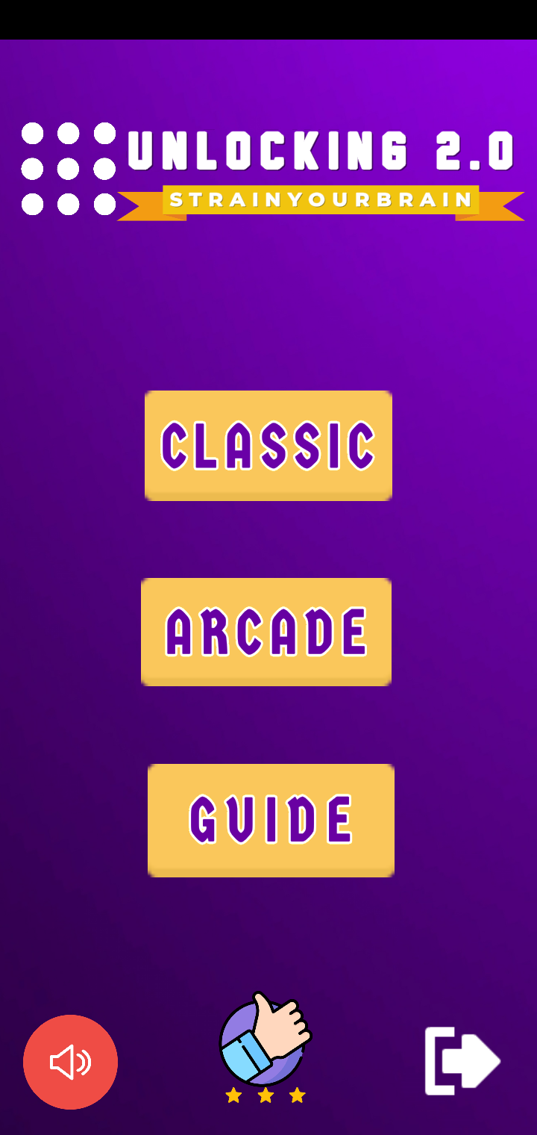
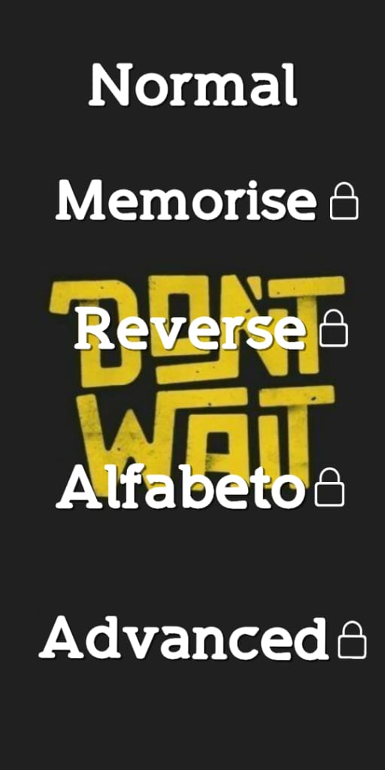
Home and classic mode SCREENS

Slide 32
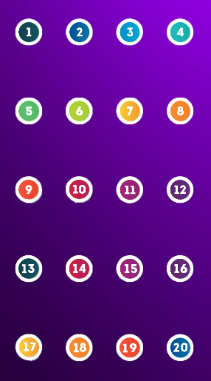
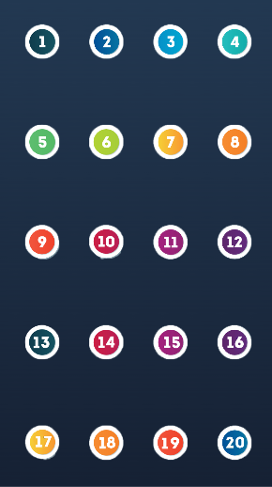
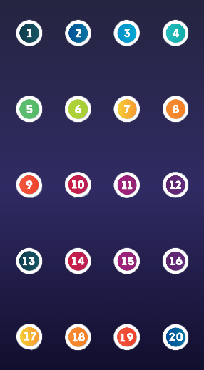
Chapter screens

Slide 33

normal and Memorise chapters screens

Slide 34
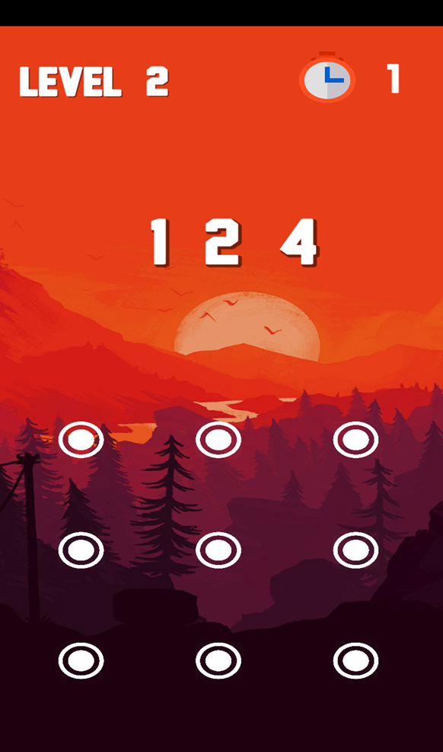
Reverse and alfabeto chapters screens

Slide 35
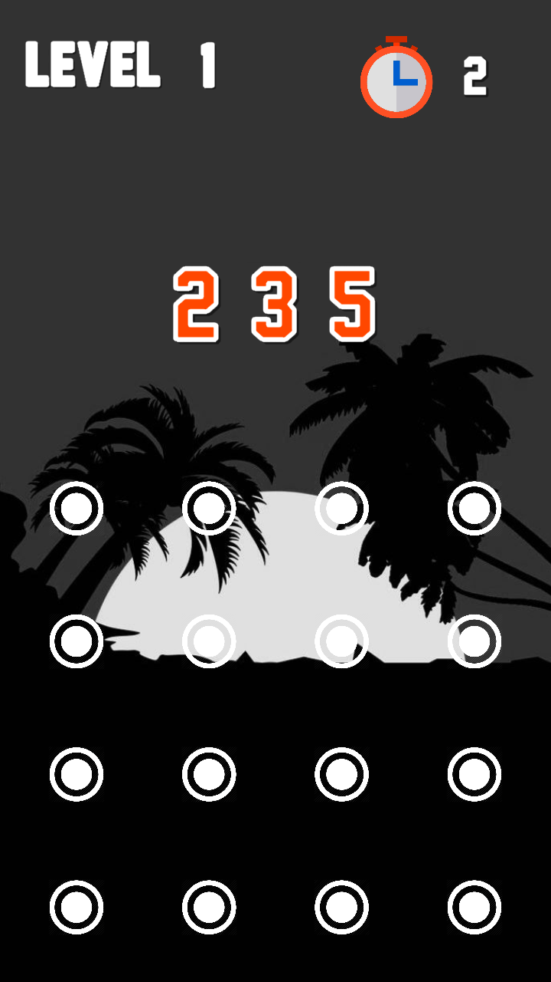
Advanced chapter screens

Slide 36
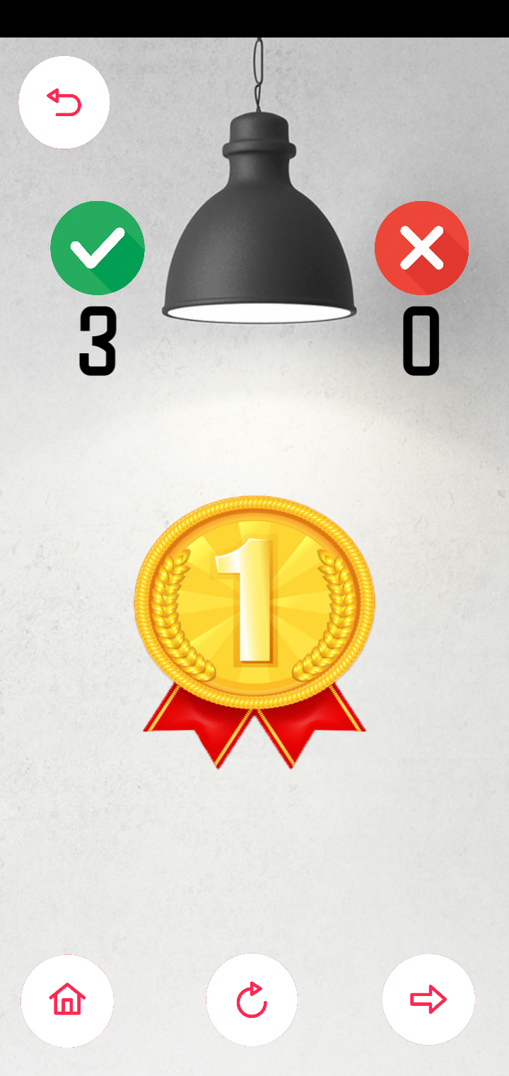
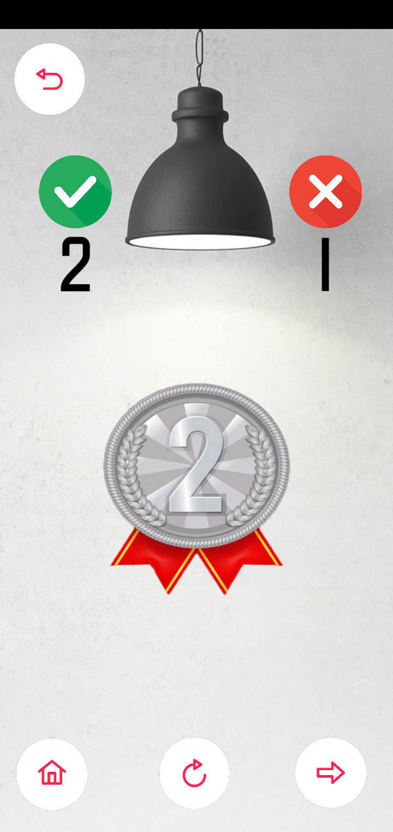
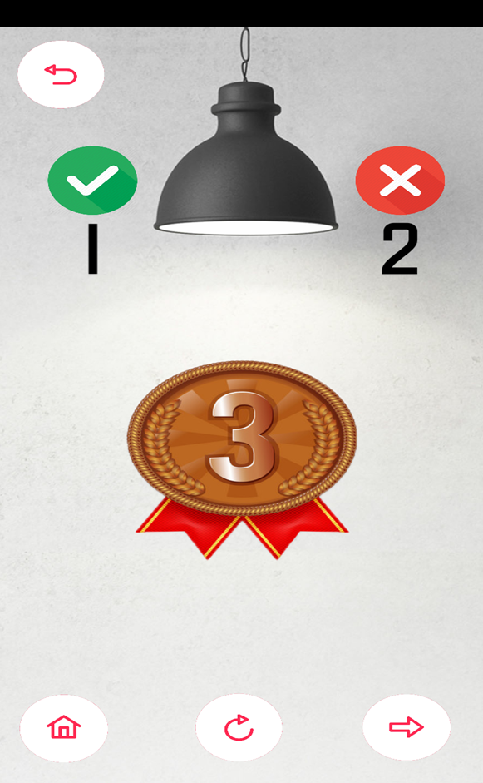
Medals screens

Slide 37
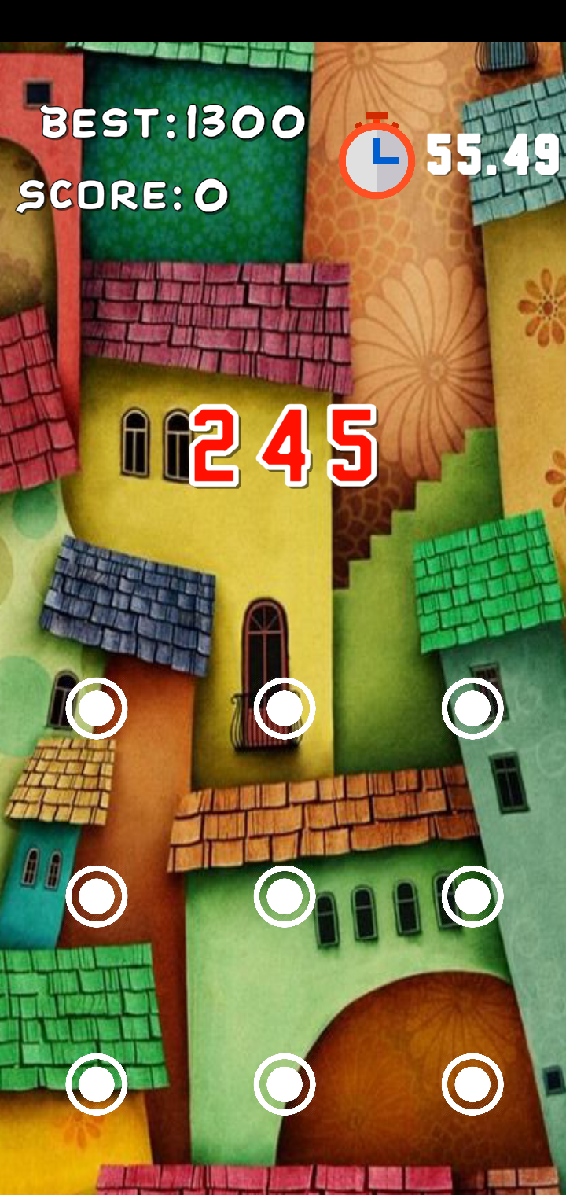
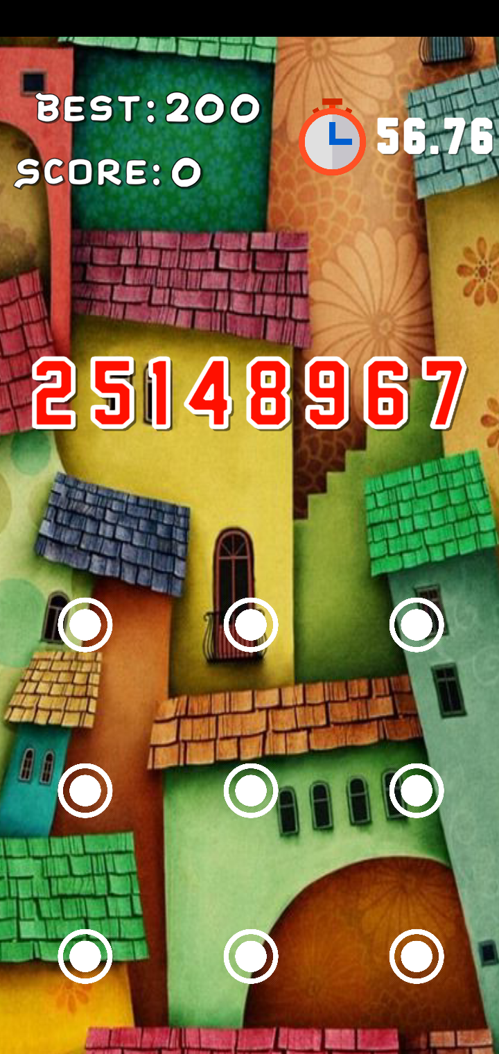
Arcade mode screens

Slide 38

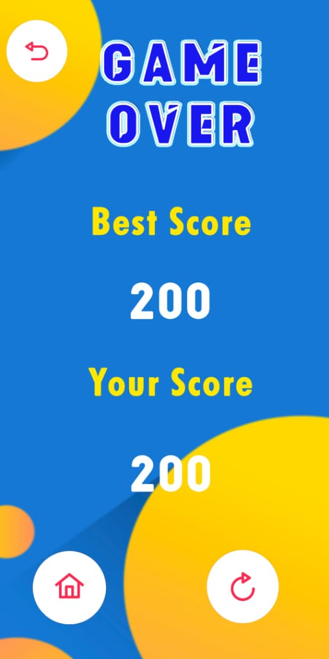

Slide 39
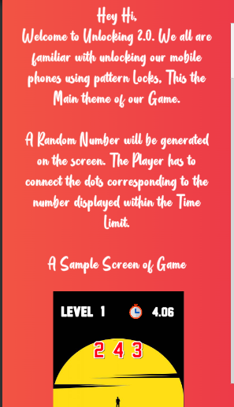
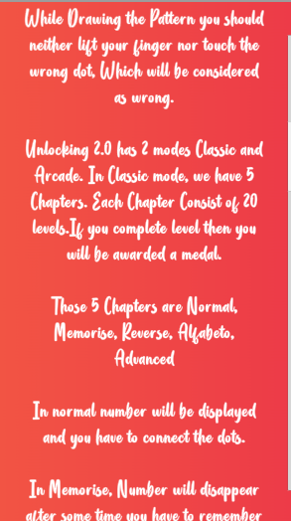
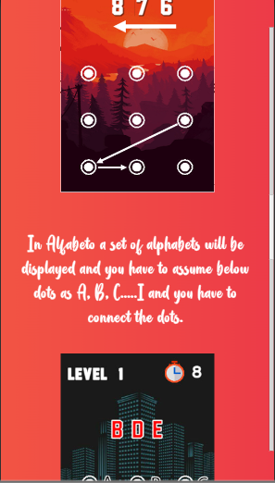
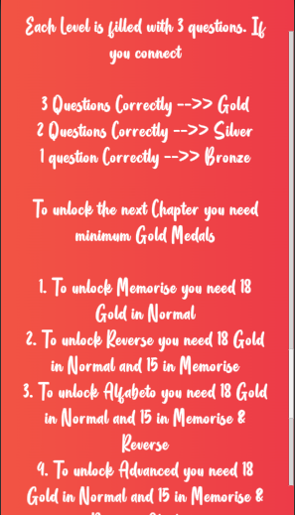
Guide screens

Slide 40
Testing and Validation
Game testing, a subset of Game Development, is a software testing process for quality control of video games. The primary function of game testing is the discovery and documentation of software Defects (also known as bugs). Interactive entertainment software testing is a highly technical field requiring computing expertise, analytic competence, critical evaluation skills, and endurance.
Testing and Validation:
Different methods, such as unit testing, are borrowed directly from general software testing techniques. There is no standard method for game testing, and most methodologies are developed by individual game developers. Methodologies are continuously refined and may differ for different types of games. In this game, no software's are used for testing, and is done manually. The basic focus is on functionality, compatibility, Compliance testing.
There is no standard method for game testing, and most methodologies are developed by individual game developers. Methodologies are continuously refined and may differ for different types of games. Many methods, such as unit testing, are borrowed directly from general software testing techniques. Outlined below are the most important methodologies, specified for games.
Functionality testing
Compliance testing
Compatibility testing

Slide 41
S. No | Test Description | Execution Steps | Expected Result | Actual Result | Pass/ Fail
1. | Scene Manager Screen Application | 1.Expand the applications 2.Show game logo and game menus | When a user clicks the game icon in his/her mobile device, it should display him a game logo followed by the game menus.The menus like new game, options, help and exit should be displayed in this case. | Game logo is displayed. Menus are displayed. | Pass
2. | Loading an Application | Click on icon. | Select an Application icon. Game must open to a menu scene without delay. | Game is loaded within 5 seconds. It is a minimum loading time for any android application. | Pass
3. | Selecting Classic mode in the Available modes | Select Classic option from menus. Click on Classic mode. | Once a player chooses a mode and clicks a mode, Game must open with Chapters scene without any delay. | Chapter scene is displayed with 4 Chapters, where only Normal Chapter is Unlocked. | Pass
4. | Starting the new game | Select Normal option from chapters. Click on level 1. | Once a player chooses a Normal chapter and clicks a level, the game must start. | New game was started with only one level unlocked that is level 1. | Pass
5. | Unlocking the new level. | Open application. 1.Start the level 2.Complete the recent level. | When a player completes the recent level with a minimum medal, then the next level should be unlocked. | Level 2 is played and completed. The new level 3 is unlocked. | Pass

Slide 42
S. No | Test Description | Execution Steps | Expected Result | Actual Result | Pass/ Fail
6. | Increase in score | Play the game 1. Complete all the three games 2. Get gold medal | Player needs to match the pattern w ith number displayed on the scene. If player complete all the three games given in a level then player can be able to get gold medal, if completed only games able to get silver medal, if completes only single game bronze medal is given. | Keep on practicing and playing the game helps the player to reach the gold medal after completing all the three game within the time limit. | Pass
7. | Saving the medals | Play each level Get medal Check medal | On completion of each level certain medals are obtained by the player. These medals are stored based on each level. And medals must be displayed in each level icon. | Level 1 was cleared; gold medal was obtained. This medal was displayed on the bottom of level 1 icon | Pass
8. | Updating high medal | Play the level again to beat the previous medal. | If same level is played again, and obtain the high medal, the high medal must be updated. | Level 1 was played again the new medal was gold. The new high medal was updated to gold for level 1. | Pass
9. | Level completion display | Complete the level | Once the level is completed,level completion message should be displayed. | Player completed the level 1 and level completion message with small greeting was displayed. | Pass
10. | Back button | Going to Level scene | Clicking on Back button should take the player to Level scene | Player will be taken to Level scene after immediately clicking the Back button | Pass

Slide 43
S. No | Test Description | Execution Steps | Expected Result | Actual Result | Pass/ Fail
11. | Next Button | Going to Next Level | Clicking on Next button should take the player to next Level only if the player gets minimum of bronze medal in the current level | Player will be taken to next Level after immediately clicking the Next button after getting minimum of bronze medal | Pass
12. | Home button | Going to Main Menu | Clicking on Home button should take the player to Main Menu scene | Player will be taken to Main Menu scene after immediately clicking the Home button | Pass
13. | Unlocking next chapters | Get Minimum required medals in the current Chapter | Player need to get some minimum required medals to unlock the next consecutive Chapters | User after reaching the Minimum required medals in the current Chapter can able to Unlock the next consecutive Chapters | Pass
14. | Unlock Memorise Chapter | Complete the Normal Chapter | To Unlock the Memorise Chapter player, need to get Minimum of 18 gold medals in Normal Chapter | User will be Unlocked the Memorise Chapter after reaching 18 gold medals in the Normal Chapter | Pass
15. | Unlock Reverse Chapter | Complete the Memorise Chapter | To Unlock the Reverse Chapter player, need to get Minimum of 15 gold medals in Memorise Chapter | User will be Unlocked the Reverse Chapter after reaching 15 gold medals in the Memorise Chapter | Pass

Slide 44
S. No | Test Description | Execution Steps | Expected Result | Actual Result | Pass/ Fail
16. | Unlock Alfabeto Chapter | Complete the Reverse Chapter | To Unlock the Alfabeto Chapter player, need to get Minimum of 15 gold medals in Memorise Chapter | User will be Unlocked the Alfabeto Chapter after reaching 15 gold medals in the Reverse Chapter | Pass
17. | Unlock Advanced Chapter | Complete the Alfabeto Chapter | To Unlock the Advanced Chapter player, need to get Minimum of 15 gold medals in Alfabeto Chapter | User will be Unlocked the Advanced Chapter after reaching 15 gold medals in the Alfabeto Chapter | Pass
18. | Random number generated | Number generated should be unique and vary from game to game | Each time player open the game Number generated should be different and unique and should vary from game to game | User will feel the difference of the Number generated and each time user opens the same game different number will be generated using the Random function | Pass
19. | Random Number Generated | Number generated should be unique and vary from game to game | Each time player open the game Number generated should be different and unique and should vary from game to game | But Sometimes Same number may be generated (1% probability) | Fail
20. | Matching the Pattern | Match the pattern with Number generated | Player need to match the Number with the Number generated to complete the game if else player couldn’t match the pattern moves to another game immediately. | User match the Number with the Number generated and complete the game if else player couldn’t match the pattern moves to another game immediately. | Pass
21. | Setting Time | Each game should be completed in the given time | Player needs to match the pattern within the time given | User will be matching the pattern within time to get medals. Time will be vary from level to level based on the difficulty | Pass

Slide 45
S. No | Test Description | Execution Steps | Expected Result | Actual Result | Pass/ Fail
22. | Increasing the Difficulty in the Levels | Level to Level difficulty should be Increased | Player need to feel the difficulty from Level to Level | User will be feeling difficulty from Level to Level based on the increase in the size of the digit of the number to be matched and decrease in the time | Pass
23. | Selecting Arcade mode in the Available modes | Select Arcade option from menus. Click on Arcade mode. | Once a player chooses a mode and clicks a mode, Game must open with Modes scene without any delay. | Chapter scene is displayed with 3 modes. 1. Easy 2. Medium 3. Hard | Pass
24. | Play Easy Mode | Select Easy mode from Arcade mode | Time will be 60sec in Easy mode with a smaller number (3-5) | User will be given with the 60sec of time and less digits of number will be displayed to decrease the difficulty of the game. | Pass
25. | Play Medium Mode | Select Medium mode from Arcade mode | Time will be 60sec in Medium mode with a Average number (5-7) | User will be given with the 60sec of time and average digits of number will be displayed to set the medium difficulty of the game. | Pass
26. | Play Hard Mode | Select Hard mode from Arcade mode | Time will be 60sec in Hard mode with number (7-9) | User will be given with the 60sec of time and large digits of number will be displayed to increase the difficulty of the game. | Pass
27. | Score Updating in Arcade Mode | Each time Score should be Updated | Each time Player plays the Arcade game high score should be updated | User after playing the Arcade game every time High score will be Updated | Pass

Slide 46
S. No | Test Description | Execution Steps | Expected Result | Actual Result | Pass/ Fail
28. | Storing the High Score In Arcade Mode | Update the High Score | Check for the previous score and compare the both scores and update the highest score as the High Score | User previous score will be checked and compared the both scores and update the highest score as the High Score | Pass
29. | Pattern Matching | Match pattern with the Number generated | Player should be matching the number with the pattern and system should detect whether the patter matches with the number or not | user will be matching the number with the pattern and system should detect whether the patter matches with the number or not | Pass
30. | Ads | Ads included in the game for Monetization | Ads should be inserted in the game through the Google AdSense for Monetization | Ads are inserted and implemented in the game through the Google AdSense for Monetization | Pass
31. | Ads | Ads included in the game for Monetization | Ads should be inserted in the game through the Google AdSense for Monetization | Sometimes ads fail to fetch and display | Fail
32. | Setting background music | Go to menu Click ‘Options’ Turn ON/OFF background music. | A player can either turn ‘ON’ or turn ‘OFF’ the background music. If turned ‘OFF’, the music should not be played on the game-play and vice-versa. | Player turned off the background music on the main screen. No background music was played on the game play. | Pass
33. | Navigate to guide option | Go to menus Click the ‘guide menu’ | If user seeks any help on the game play, he can gather the information from guide menu. | User clicked the ‘Guide’ menu; the game play information was displayed. | Pass
34. | Checking Rate Us button | In Main Menu Click on Rate Us | Player should be Redirected to Play store “UnlocKing” Page for giving the Reviews and Ratings | User Redirected to Play store “UnlocKing” Page for giving the Reviews and Ratings | Pass
35. | Exit the game | Go to main menu Click on ‘Exit’ button | On clicking the ‘Exit’ button; the game must quit. And the control must return to the Android home screen. | Player clicked the ‘Exit’ button to quit the game and finally return to his home screen. | Pass

Slide 47
CONCLUSION & FUTURE ENHANCEMENT
The game “UnlocKing 2.0” is now available in Play Store for Android users with ads.
Game is launched and consists more than 100+ downloads till date. we are concentrating on more promotions of the game make it to reach everyone and have more downloads.
New levels and chapters will be added
Improved user interface.
Flexible for online and offline environment.
More confusing and unique levels will be introduced
Premium version with no ads.
Launch in AppStore

Slide 48
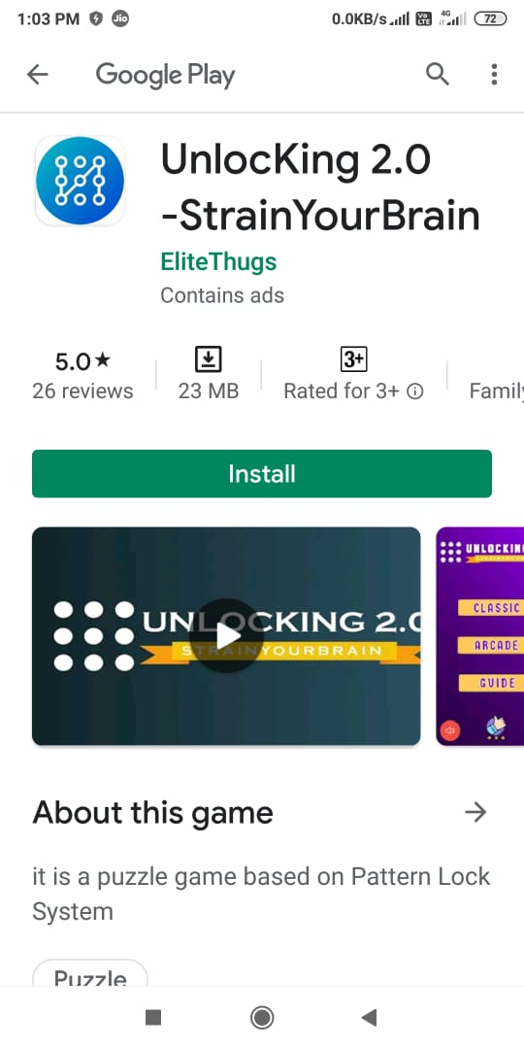
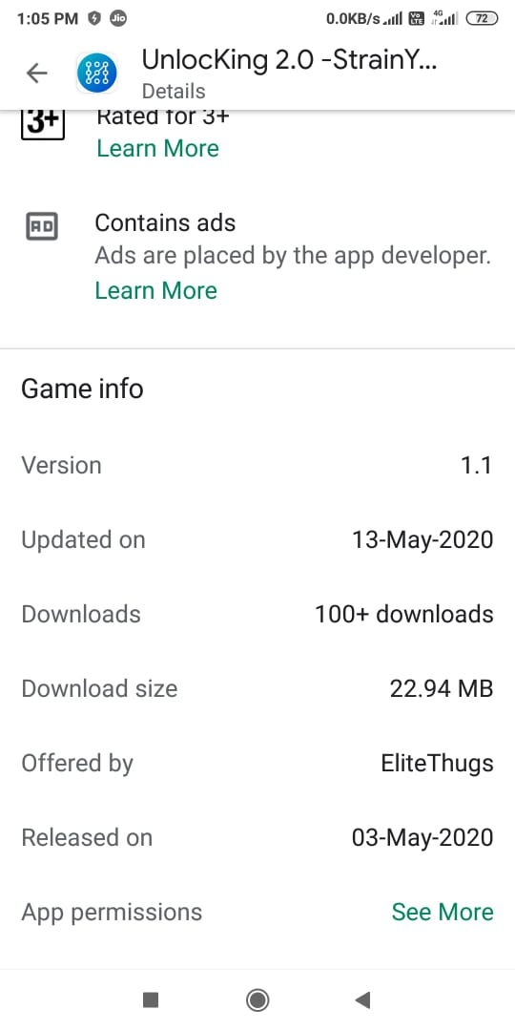
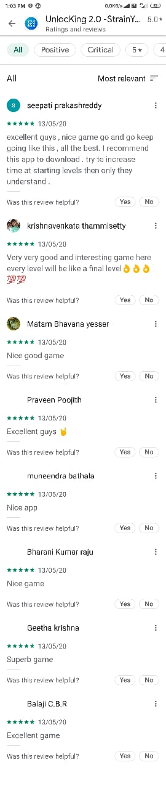
PLAY STORE link
UnlocKing 2.0 [STRAIN YOUR BRAIN]
https://play.google.com/store/apps/details?id=com.elitethugs.unlocking2
2.0

Slide 49
REFERENCEs
Installing Unity: https://www.youtube.com/watch?v=_QWSNB1_SxU
Installing Visual Studio: https://www.youtube.com/watch?v=2PVPz8Pnnrw
Basic Unity Tutorials: https://www.youtube.com/watch?v=Ep0rlBQRcVc
Unity User Manual: https://docs.unity3d.com/Manual/index.html
Basic Krita usage: https://www.youtube.com/watch?v=kUXNEK8awiY
Krita User Manual: https://docs.krita.org/en/
Basic Illustrator usage: https://www.youtube.com/watch?v=Kgmu8RwLi28
The complete beginners guide to Adobe Illustrator:
https://www.pgsd.org/cms/lib07/PA01916597/Centricity/Domain/202/illustrator_for_beginners_tastytuts.pdf
Basic Photoshop usage: https://www.youtube.com/watch?v=pFyOznL9UvA
Photoshop User Manual: https://helpx.adobe.com/in/photoshop/user-guide.html

Slide 50

THANK YOU

